Slide 1
Ornithobilharzia turkestanicum
Orienthobilharzia spp. is a Schistosomes infection that cause Orientobilharziasis disease in a large number of animals including goats, sheep, cattle and other mammals and they live in the portal or intestinal veins of the infected animals with causing emaciation, anemia and diarrhea, with incidence extraction of blood and mucosal material in the host feces, and infection may lead to acyesis or abortion in females and reduce the possibility of growth in young with wide spread in many countries at the world including Russia, Mongolia, Turkey, India, Iran, China and Iraq.

Slide 2
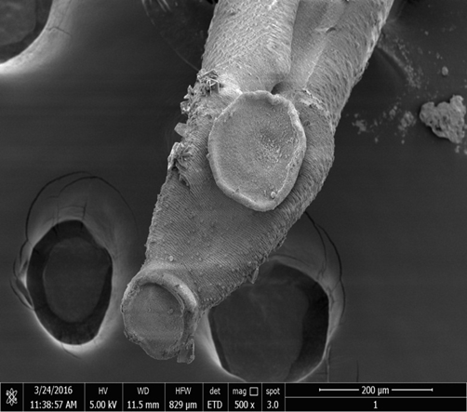
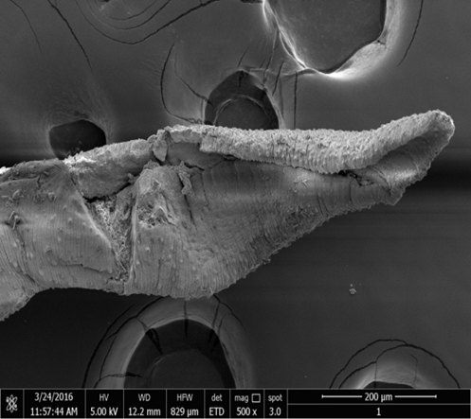
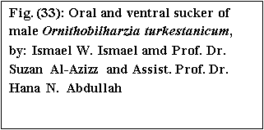
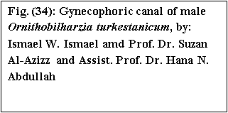

Slide 3
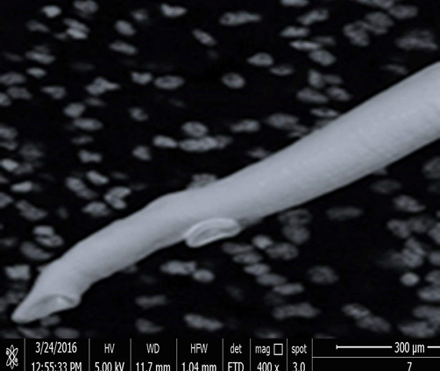
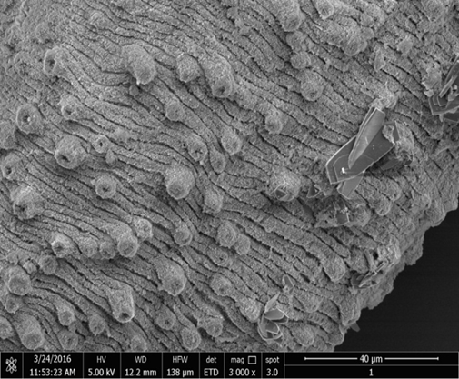
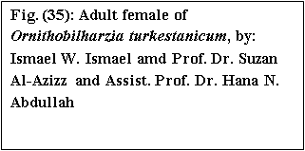
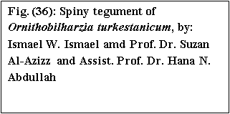

Slide 4
Schistosoma cercarial dermatitis or swimmers itch
Schistosoma of animals or birds other than man (usually rodents and birds) try to penetrate the skin of man, they cannot establish themselves in the blood vascular system of man causing sores in different part of their body and the causing called swimmer's itch or diggers itch, where cercaria penetrate skin, die, Often cause a dermatitis which can be severe and in some cases life threatening and cause type of inflammation and allergic reaction in abnormal hosts with few days later it’s disappear.

Slide 5
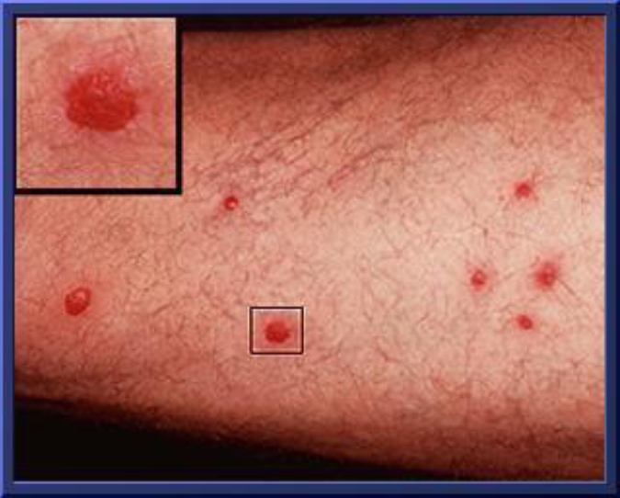


Slide 6
THANK YOU

